Slide 1
New Beginnings
2023

Slide 2
Welcome to The Team…
“As Headteacher, I’d like to welcome you to our wonderful community of learners at Sackville! You’ll find that the school is very friendly and you will be strongly encouraged and supported to do your best every day that you’re here.
Sackville has many young people and staff who I’m responsible for looking after. I am lucky to be surrounded by so many great people who make sure that everything runs smoothly.
I’m based just opposite the reception area at the entrance of the school and I’m really looking forward to meeting you. Good luck!”
Ms Jo Meloni, Headteacher

Slide 3
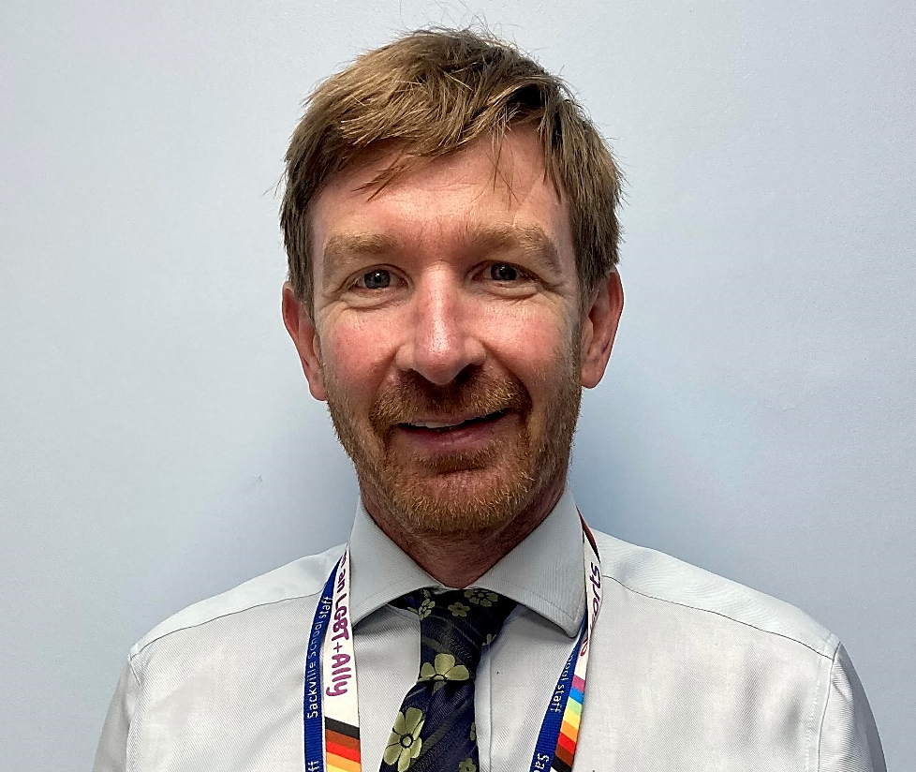
Leading the team …
“Welcome to Sackville.
My name is Mr Street and I am one of the Deputy Headteachers here at Sackville.
My responsibilities include the wellbeing of students. I’m keen that you start Sackville, feeling safe, confident and ready to learn.
I am really looking forward to meeting you on one of our transition days so I can tell you a little more about me but more importantly, find out a lot more about you. Take care and stay safe.”
Mr Street
Mr Street, Deputy Head

Slide 4
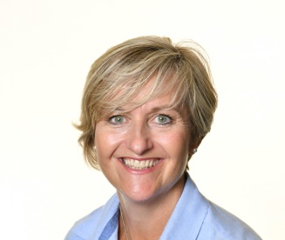
Here to support you all the way…
“My name is Mrs Brown, I am the Transition Coordinator.
My role is to manage and ensure your transition from primary to secondary school, runs as smoothly as possible.
I am in the process of speaking with your teachers to find out about you, and collecting information so we know a great deal about you before you even join us in September. I plan all the days you will be coming in for and I am the main point of contact for your parents if they have any questions or concerns about you joining.
I am really look forward to getting to know each and every one of you, and I hope I can make the journey into Sackville a happy, safe and most of all fun experience, ready for you to start great learning in September.
You will love Sackville, it is a wonderful school, full of amazing opportunities, which I encourage you to take full advantage of.
I look forward to seeing you all in July for your Induction Days.”
Mrs Brown
Mrs Brown, Transition Coordinator

Slide 5
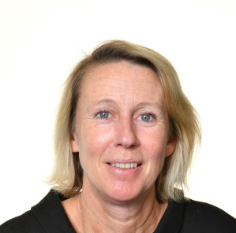
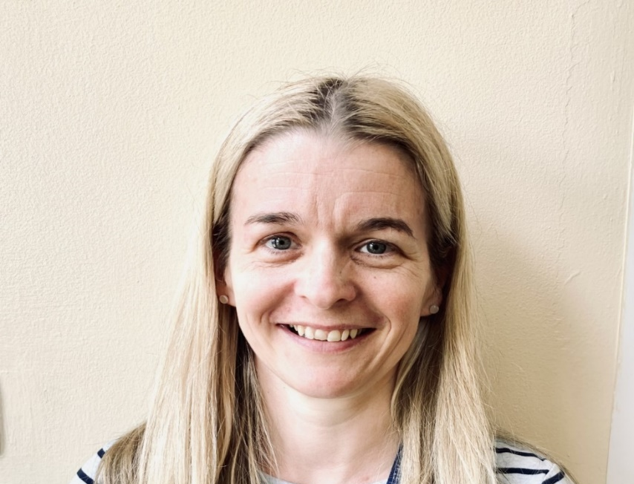
The LINK Team …
“My name is Mrs Hunt and I work in the LINK. I am the Special Needs Coordinator so I am someone who can help you or your parents if there is any extra help you need with your learning.”
Mrs Hunt
“Hello, my name is Mrs Tocher. I am the Learning Mentor at Sackville. I work closely with the year team to help support your emotional and pastoral needs. I also run The BASE which is a welcoming place to be at break and lunch times if you are unsure of where to go. I look forward to meeting you soon.”
Mrs Tocher
Mrs Hunt, Special Needs Coordinator
Mrs Tocher, Learning Mentor

Slide 6
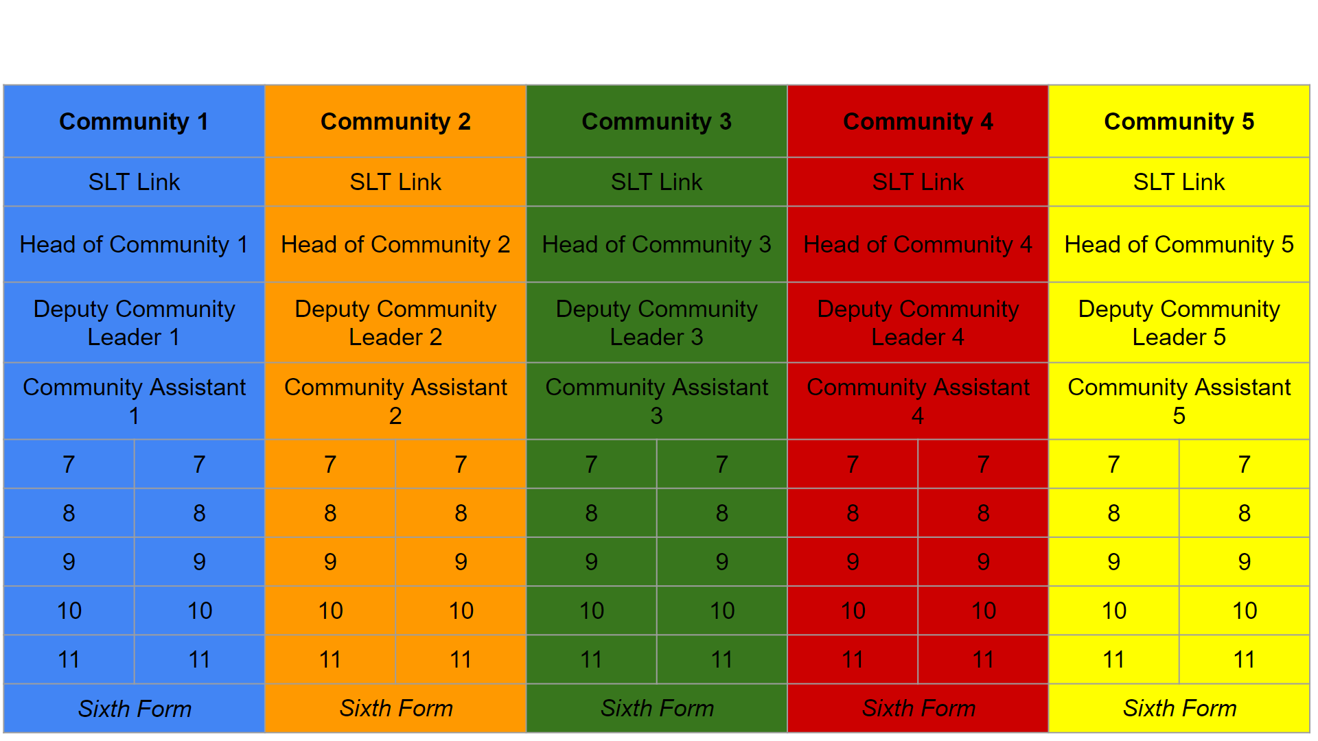
Sackville Communities

Slide 7
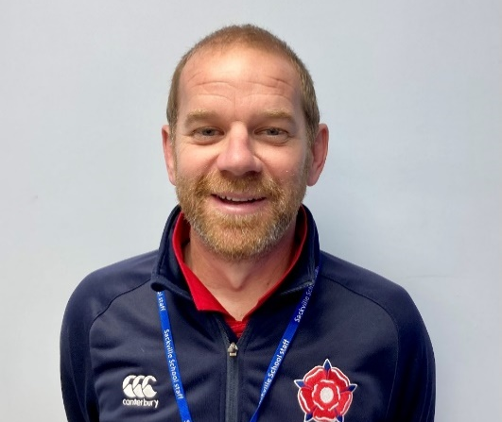
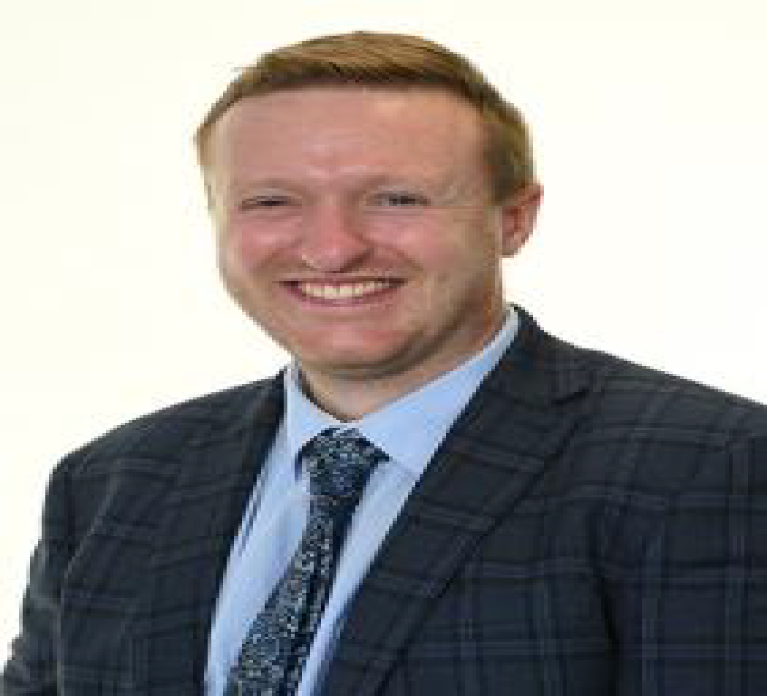
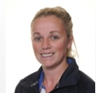
Community Leaders
Mr Endersby
Mr Pearson
Mrs Sands

Slide 8
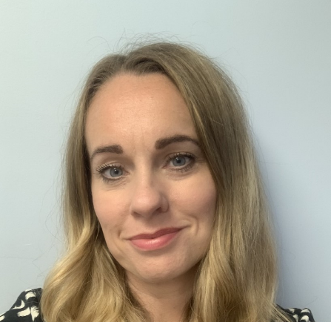
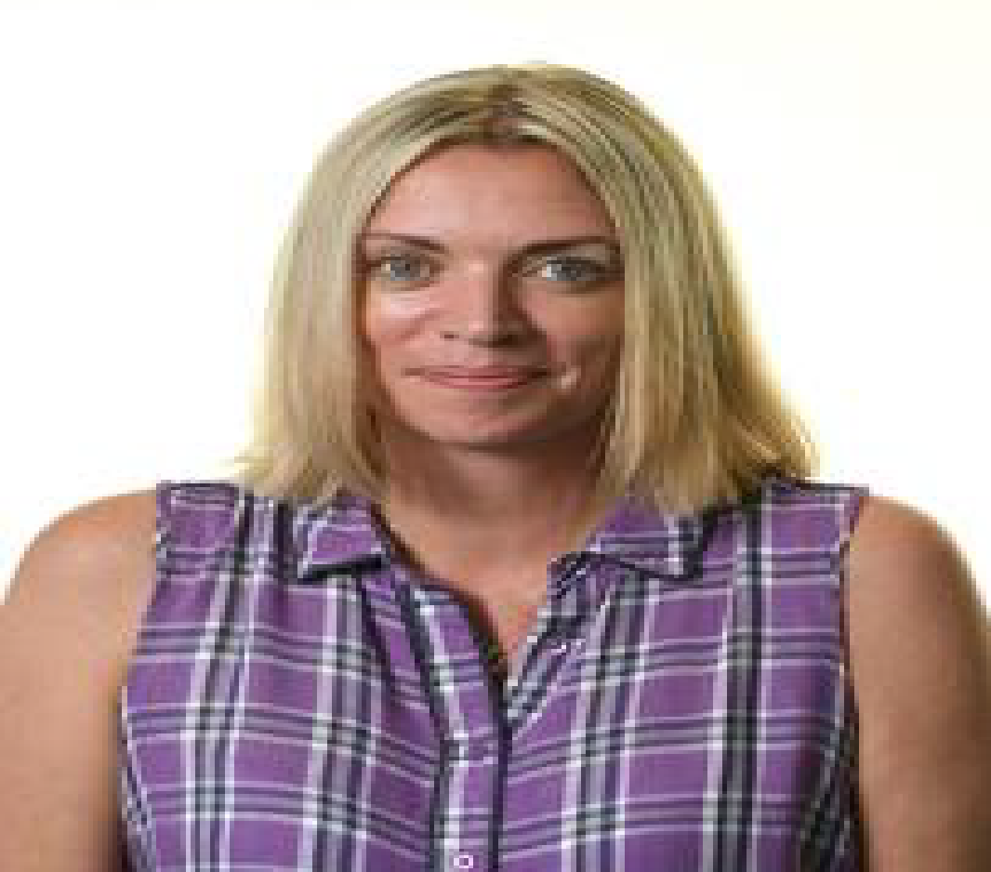
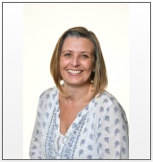
Community Assistants
Mrs Brignall
Mrs Newcomb
Mrs Hallums
Mrs Mustard
Mrs Randall

Slide 9
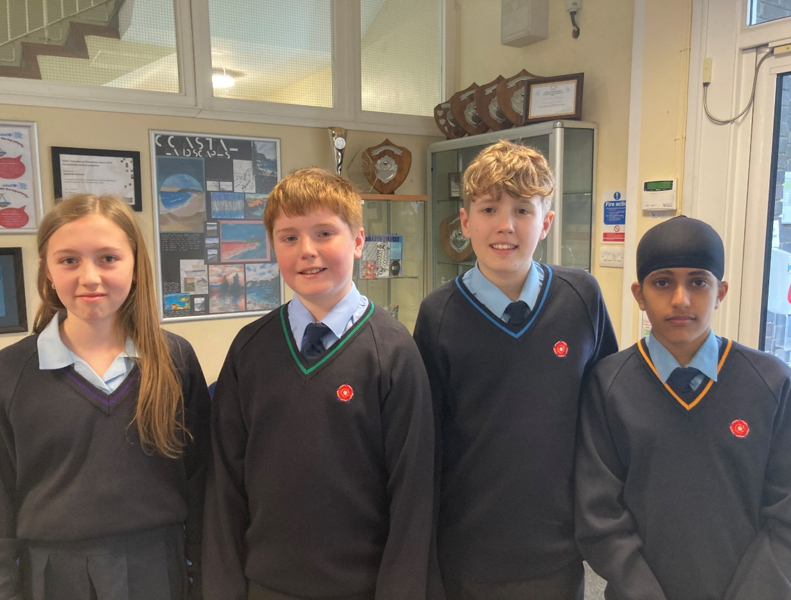
Uniform

Slide 10
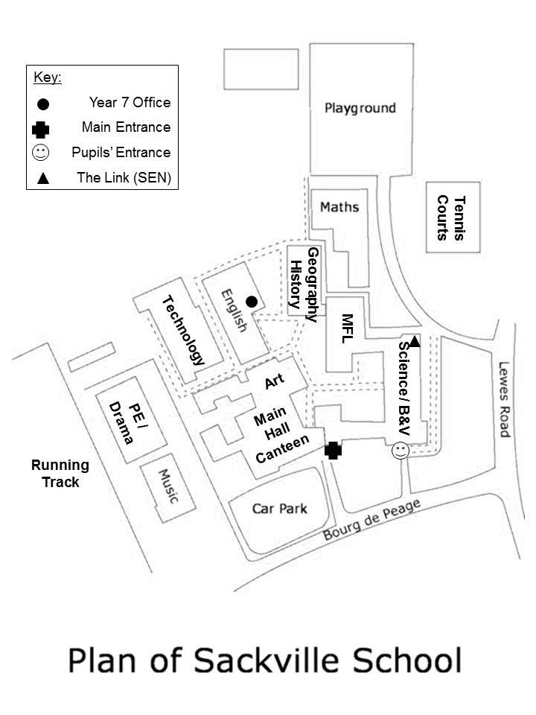
How Will I Know Where Everything Is?
Here is the plan for Sackville School. We’ve not included all the rooms and different levels as it is quite complicated. Do not worry about it, once you’re here, you’ll quickly get to know where you are going.

Slide 11
Sackville School Day
Registration
Period 1
Period 2
Break
Period 3
Period 4
Lunch
Period 5
08.25am - 08.55am
08.55am - 09.55am
09.55am - 10.55am
10.55am - 11.20am
11.20am -12.20pm
12.20pm - 01.20pm
01.20pm - 01.55pm
01.55pm -02.50pm

Slide 12
Example Timetable
Monday
Tuesday
Wednesday
Thursday
Friday
Registration
CHD D04
CHD D04
CHD D04
CHD D04
CHD D04
Lesson 1
Te
KTN T02
Fr
IGN B14
Pe
LRS Field 5
Bv
AMS A14
Fr
IGN B14
Lesson 2
Pe
LRS Field 4
Gy
MJN C04
Sc
PXW A22
Mu
THY E05
Hi
HGN C12
Sc
PWX A22
Dr
HMN P02
Fr
IGN B14
Ma
JSI B02
En
JCK D01
Lesson 3
Lesson 4
Ma
EWE B02
En
LRR D02
Hi
HGN C12
Te
HDN T01
It
JLA C15
Lesson 5
Gy
MJN C04
Ma
JSI B02
En
ADT D02
Sc
PWX A22
Ar
HBY F04

Slide 13
School Buddies
At Sackville, we’re very proud of our Buddy System.
We’ve carefully selected some of the finest Year 8 students.
They’ve all applied to be a ‘buddy’, have had training, and have the experience of what it’s like to be in the shoes of a new pupil.
You’ll meet them on the Induction Days in July and they’ll be with you in September too.

Slide 14
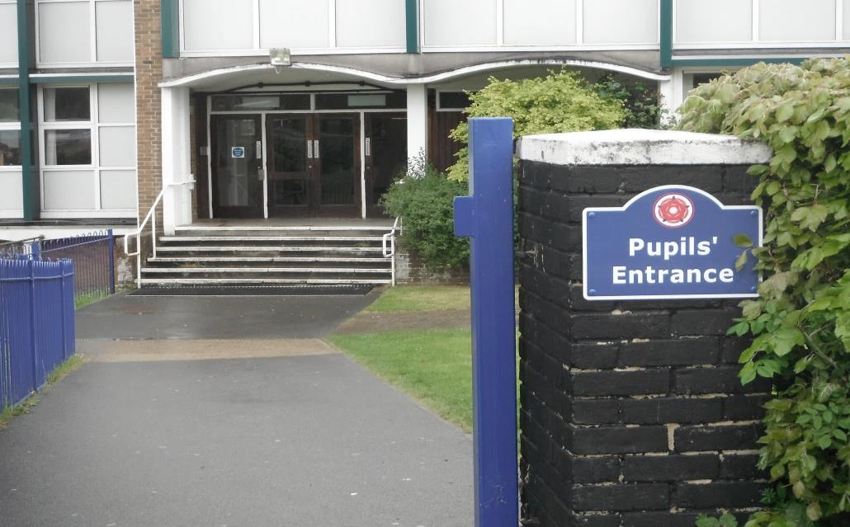
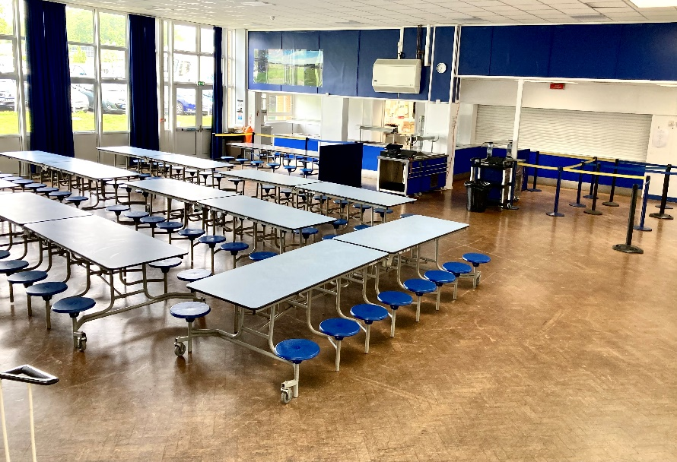
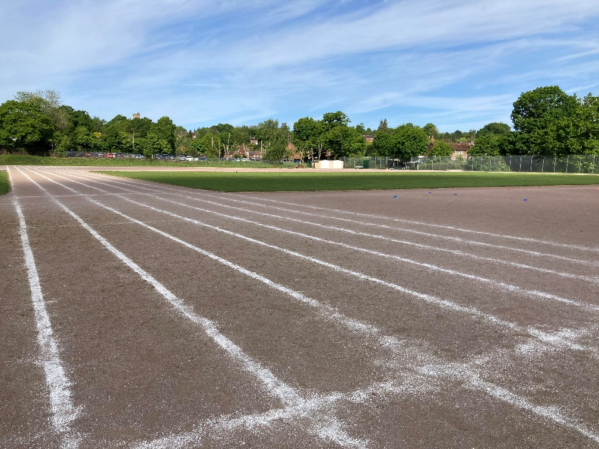
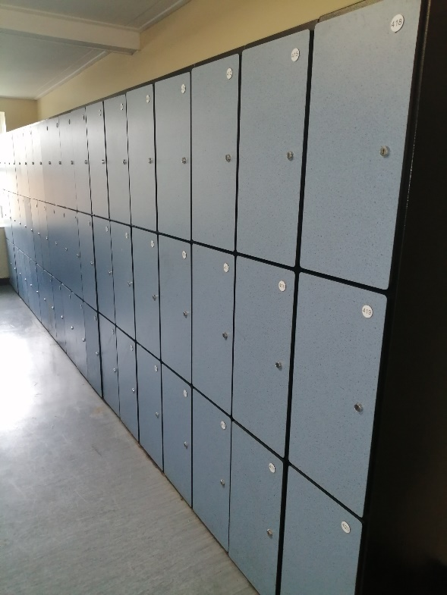
Can you guess where these
pictures are taken from?

Slide 15
Thank You.

