Slide 1
New Beginnings
2025

Slide 2
Welcome to The Team…
“As Headteacher, I would like to welcome you to our wonderful community of learners at Sackville! You’ll find that the school is very friendly and you will be strongly encouraged and supported to do your best every day that you’re here.
Sackville has many young people and staff who I am responsible for looking after. I am lucky to be surrounded by so many great people who make sure that everything runs smoothly.
I am based just opposite the reception area at the entrance of the school and I’m really looking forward to meeting you. Good luck!”
Ms Jo Meloni, Headteacher

Slide 3
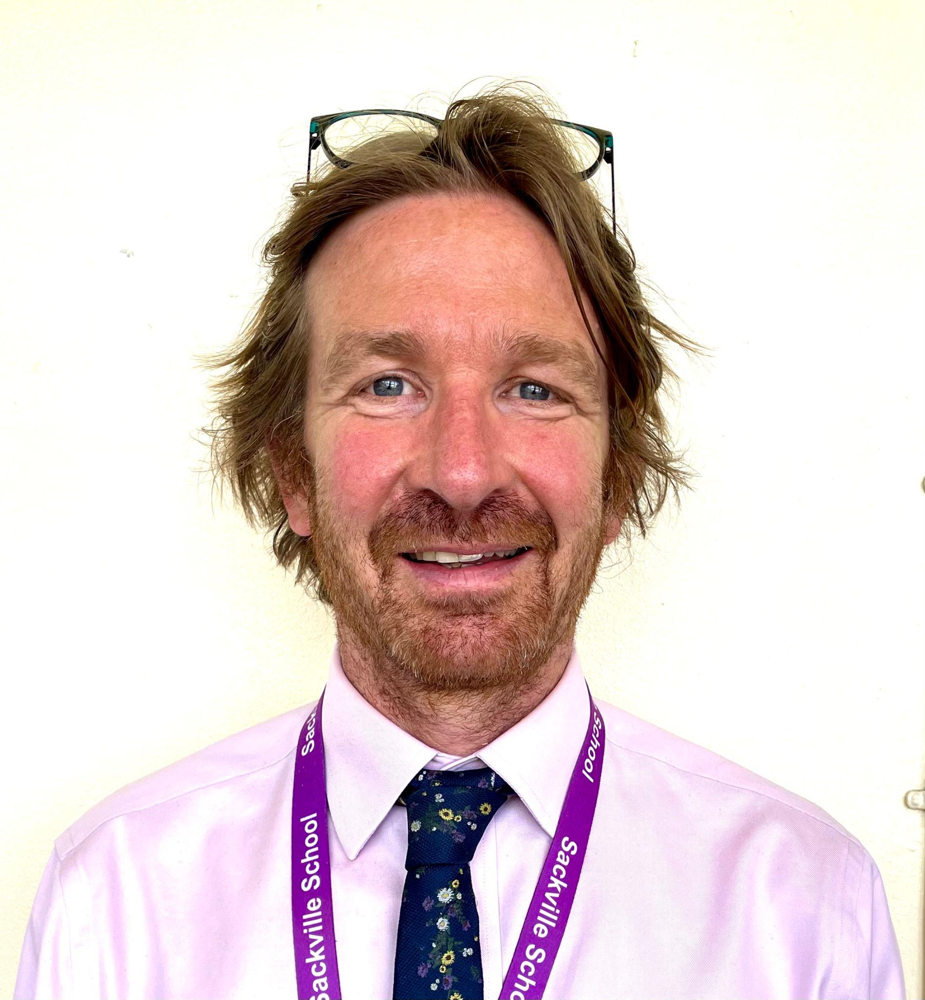
Leading the team …
“Welcome to Sackville.
My name is Mr Street and I am one of the Deputy Headteachers here at Sackville.
My responsibilities include the wellbeing of students. I’m keen that you start Sackville, feeling safe, confident and ready to learn.
I am really looking forward to meeting you on one of our transition days so I can tell you a little more about me but more importantly, find out a lot more about you. Take care and stay safe.”
Mr Street
Mr Street, Deputy Head

Slide 4
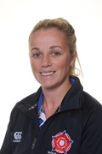
With you all the way…
“My name is Mrs Sands, I am Head of Turing Community but also the year 7 Transition leader.
My role is to manage and ensure your transition from primary to secondary school, runs as smoothly as possible.
I am in contact with your teachers and parents, collecting information so we know all about you before you even join us in September. I plan the days you will be coming in for and I am the main point of contact for your parents if they have any questions or concerns about you joining.
I am really look forward to getting to know each and every one of you, and I hope I can make the journey into Sackville a happy, safe and most of all fun experience, ready for you to start great learning in September.
You will love Sackville, it is a wonderful school, full of amazing opportunities, which I encourage you to take full advantage of.
I look forward to seeing you all in June for your personal meetings at Sackville and in July for the three Induction Days.”
Mrs Sands
Mrs Sands, Year 7 Transition Leader

Slide 5
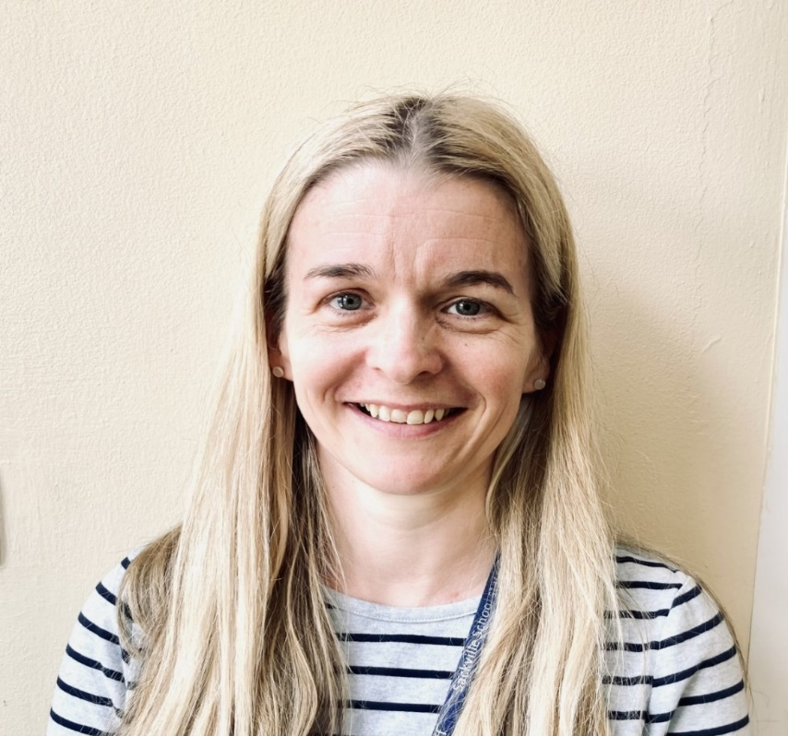
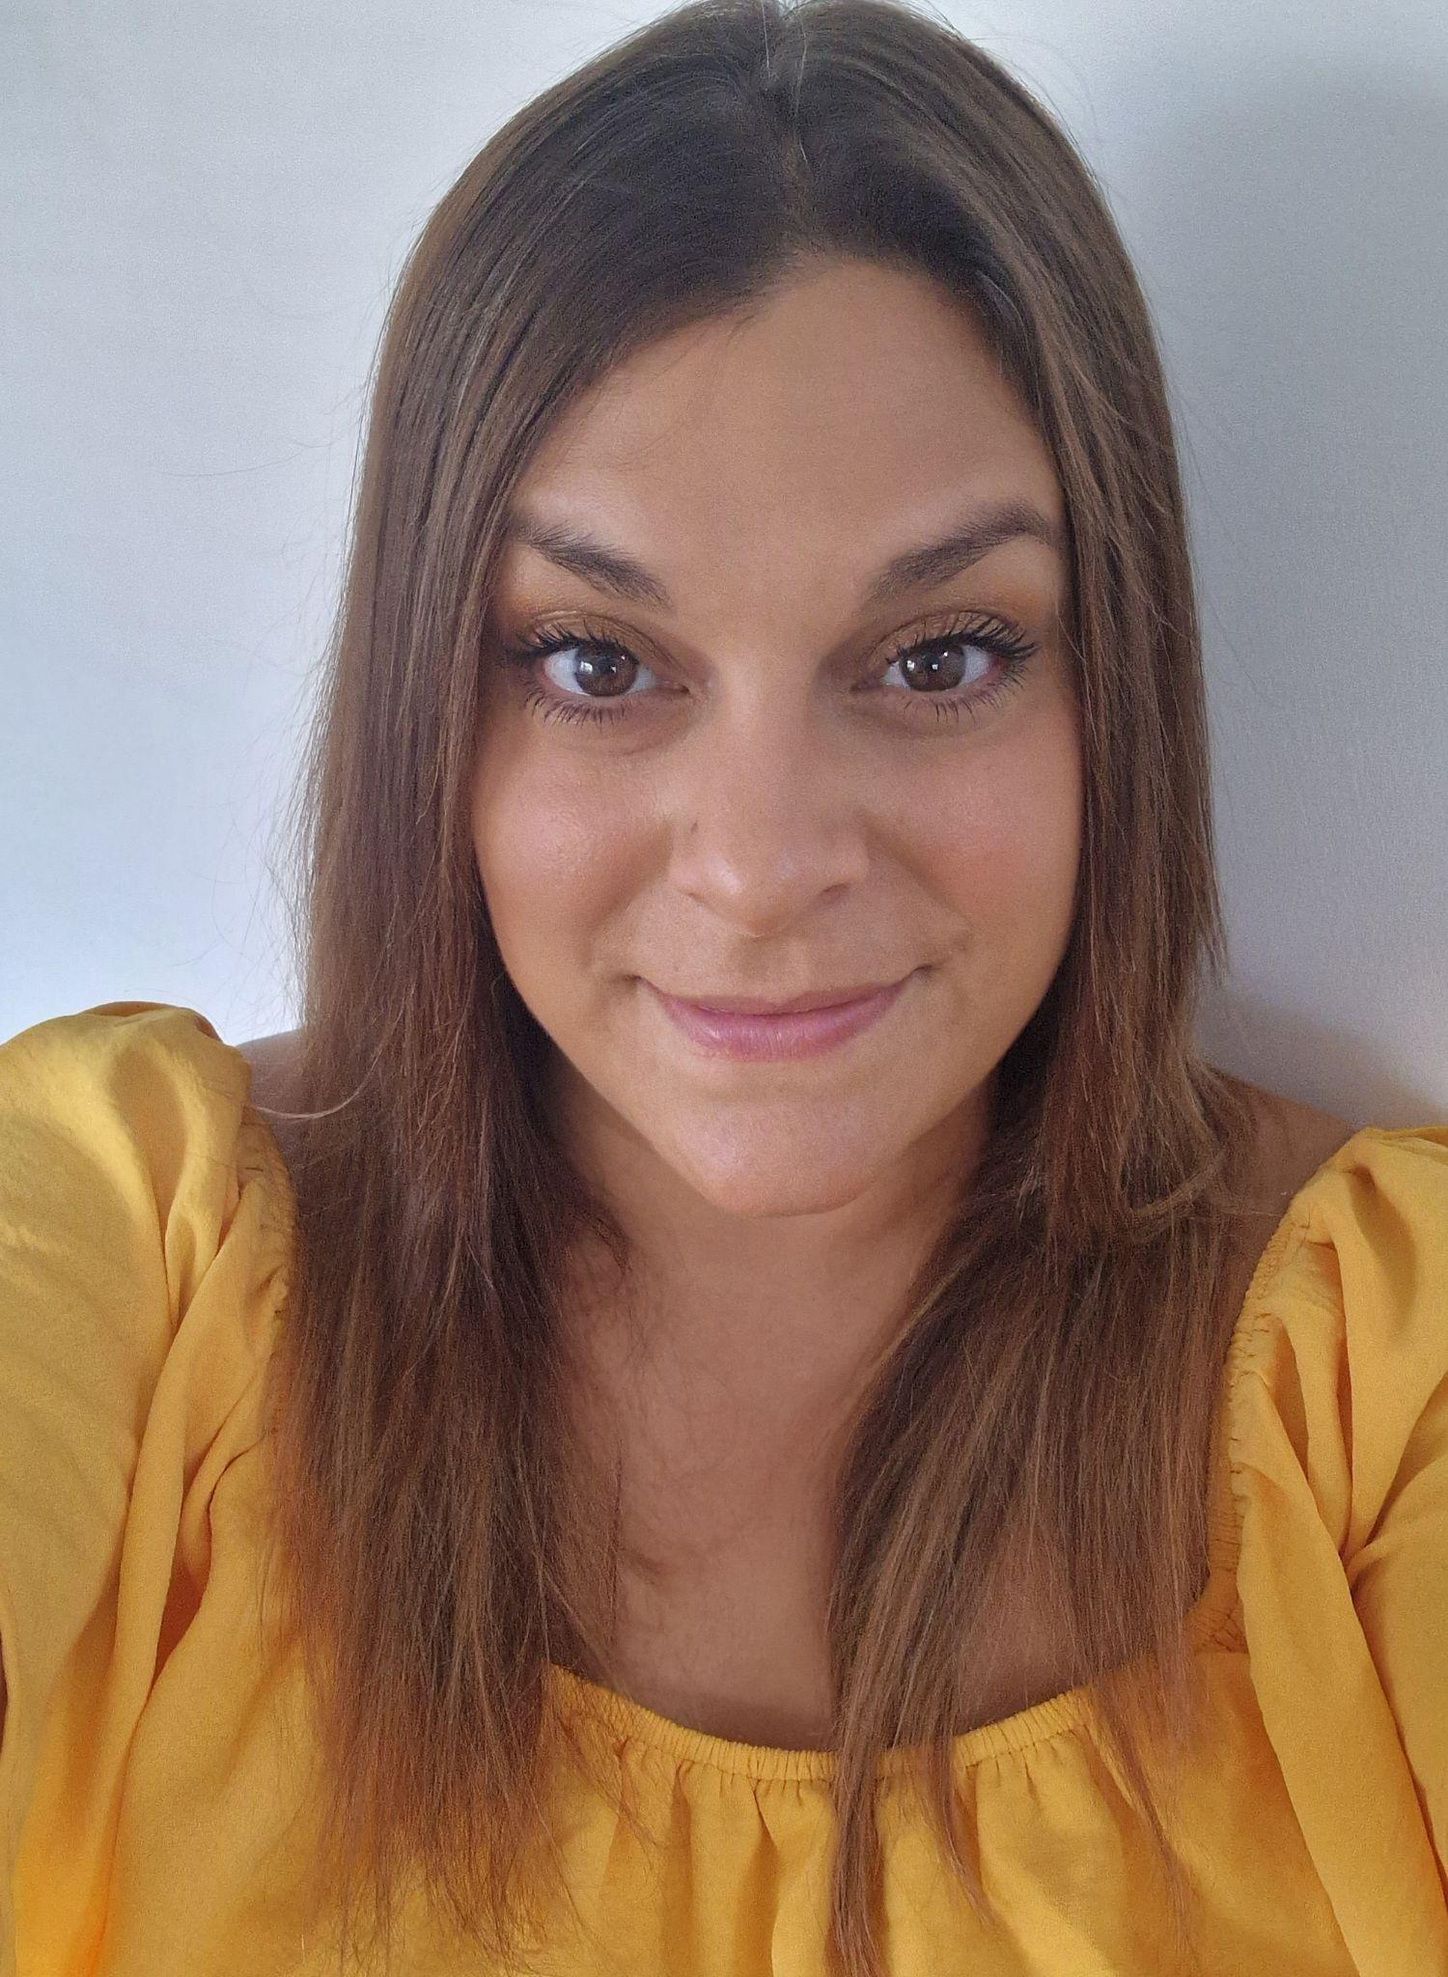
Here to support you …
Mrs Hunt, Special Needs Coordinator
Mrs Steer, Child Protection and Welfare office
“My name is Mrs Hunt and I work in the LINK. I am the Special Needs Coordinator so I am someone who can help you or your parents if there is any extra help you need with your learning.”
Mrs Hunt
“My name is Mrs Steer. I work in the Attendance and Welfare Office and my job is to support children to attend school and to keep them safe. I am looking forward to meeting you on your transition days and getting to know you, ready for when you join us in September.
See you soon!”

Slide 6
Sackville Communities

Slide 7
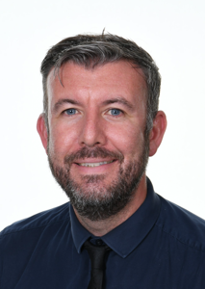
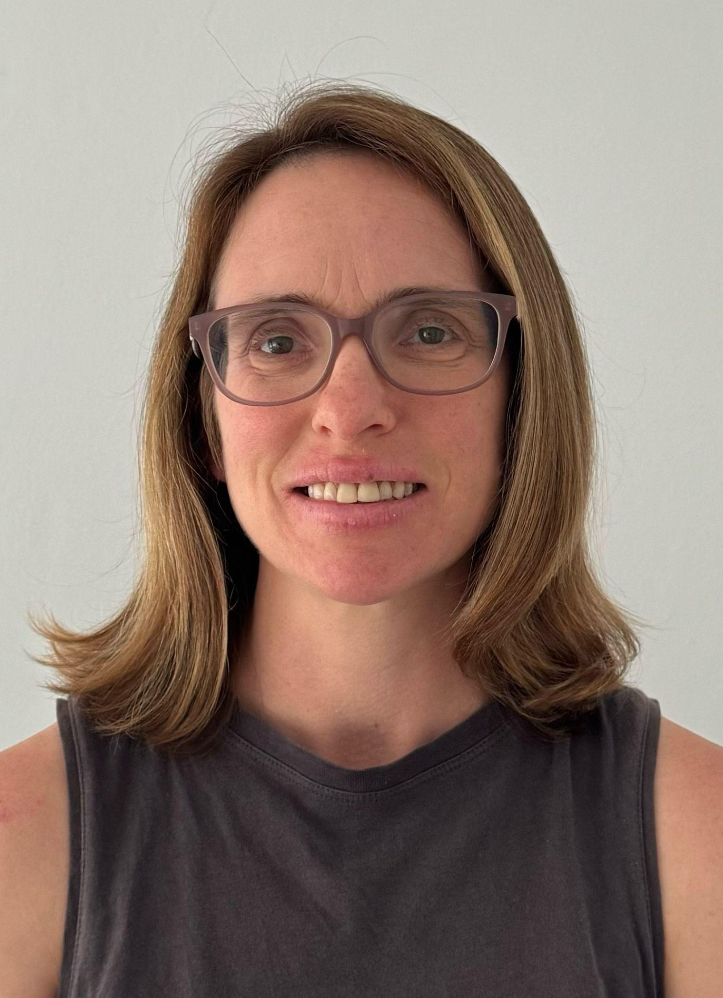
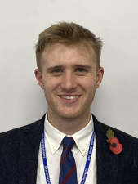
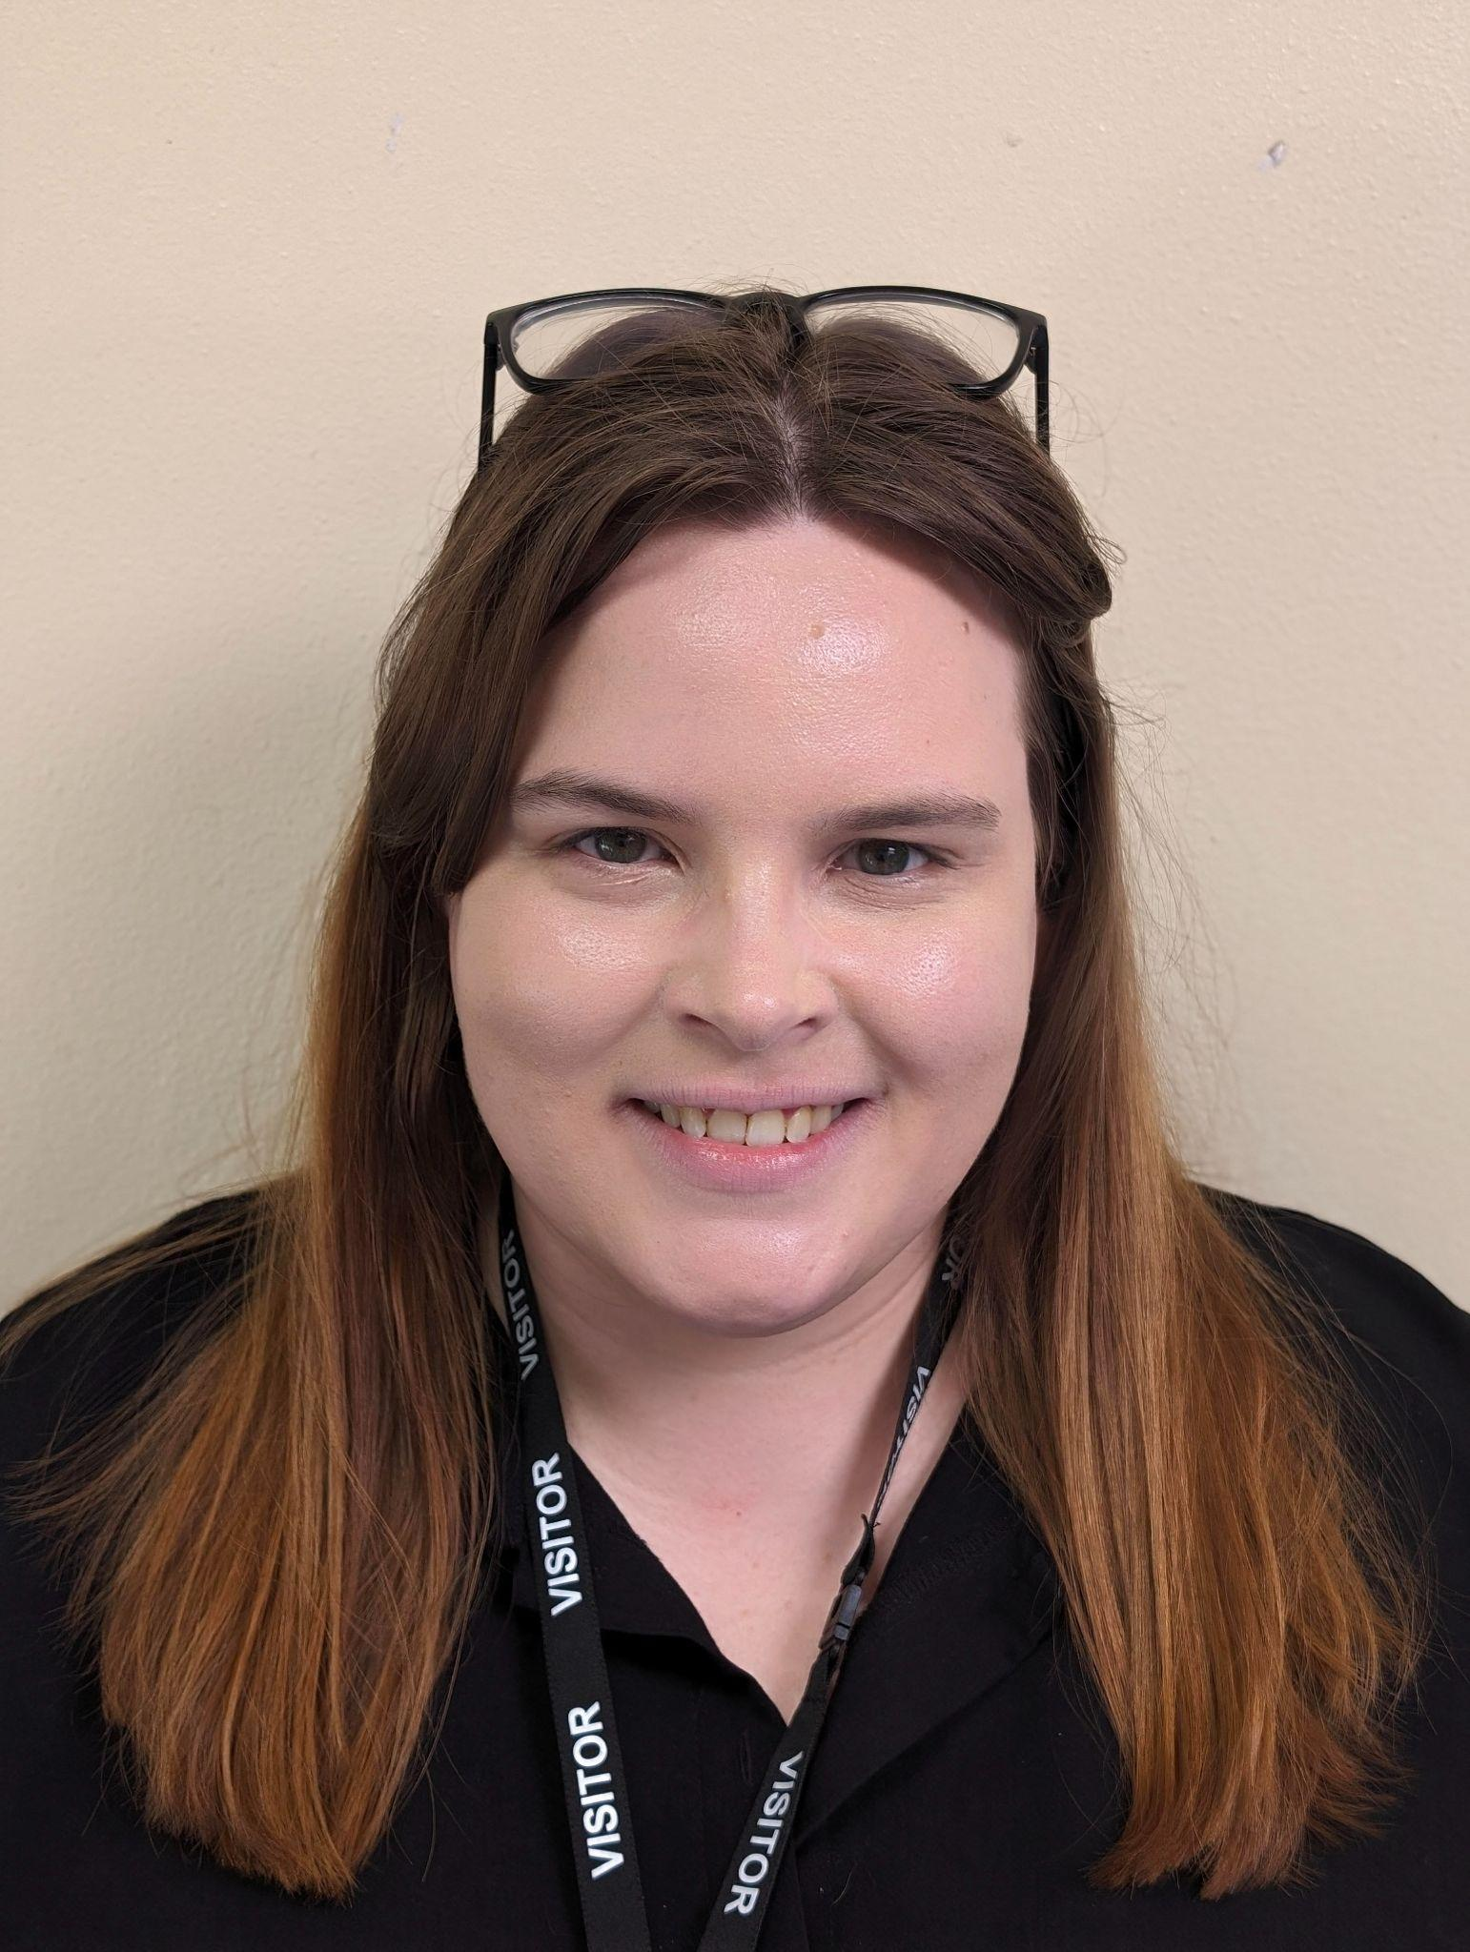
Community Leaders
Mr Turner
Mrs Ellis
Mr Beaver
Mrs Sands
Miss Mance

Slide 8
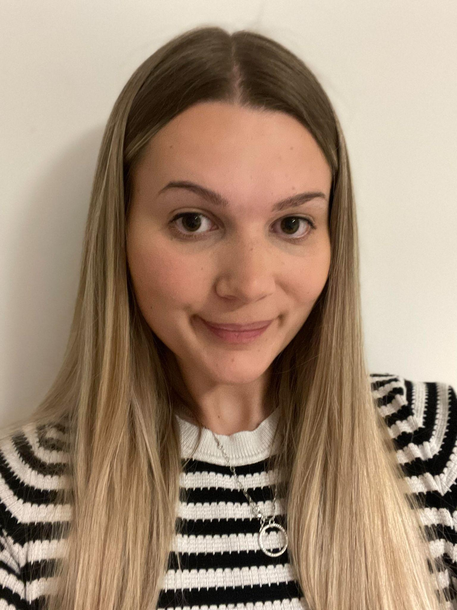
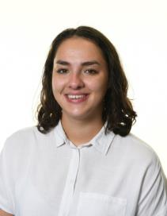
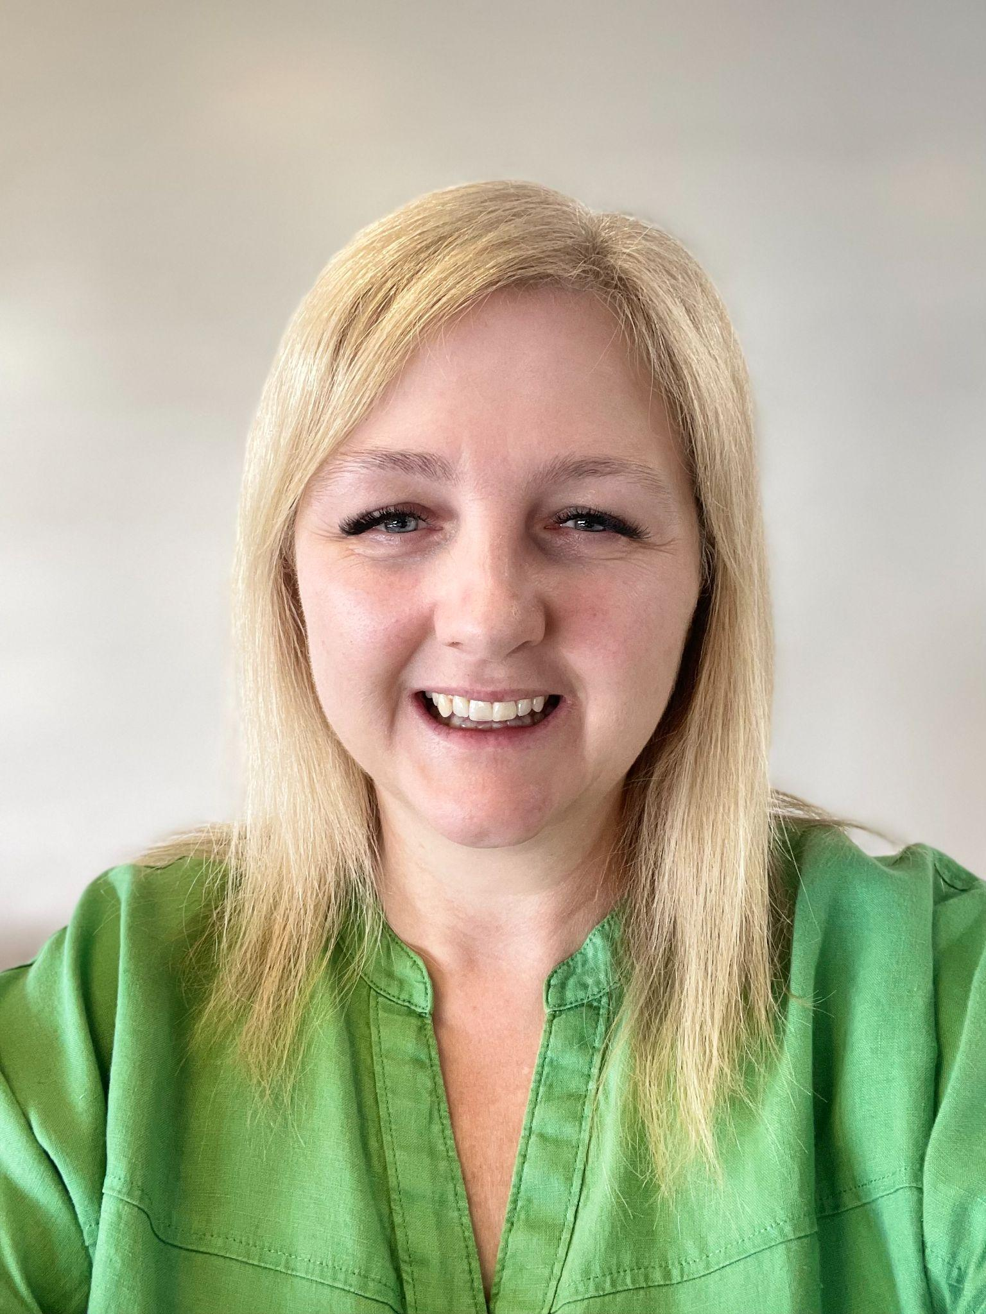
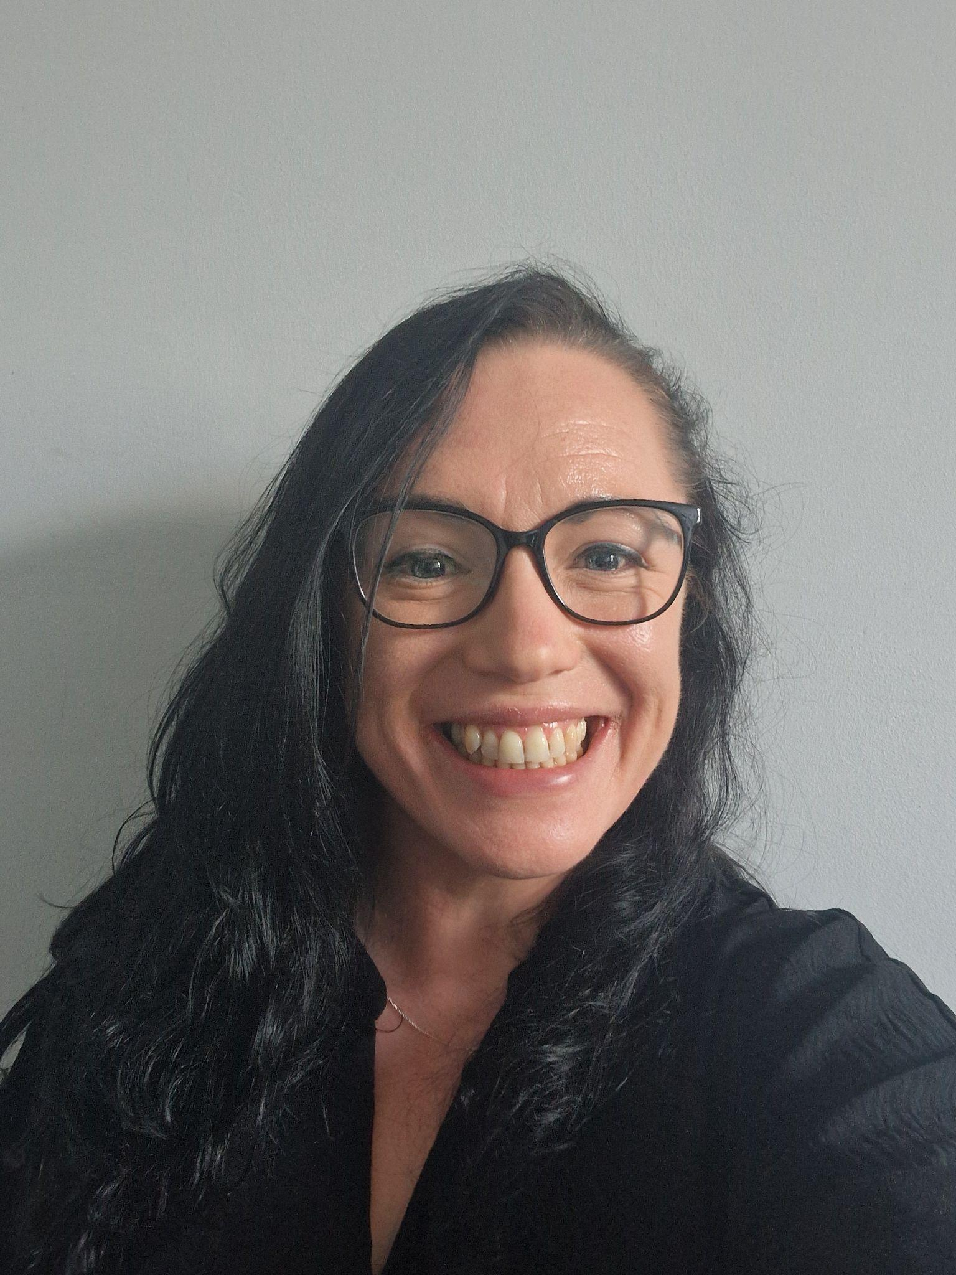
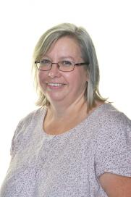
Community Deputies
Miss Burgess
Miss Parchment
Ms Wright
Miss Newman
Mrs Smith

Slide 9
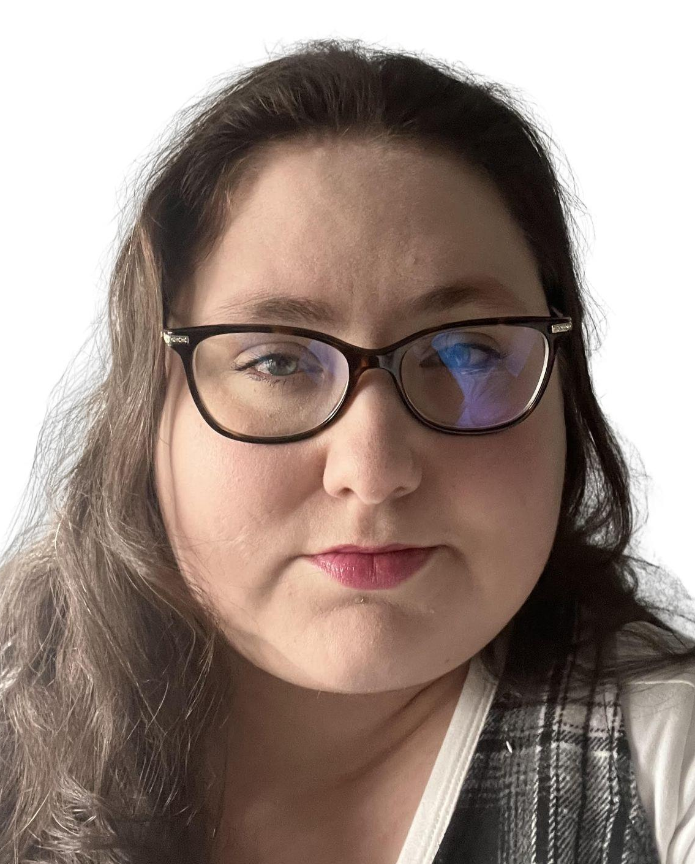
Community Assistants
Mrs Randall
Mrs Mustard
Mrs Turnbull-Allen
Mrs Newcomb
Mrs Hallums

Slide 12
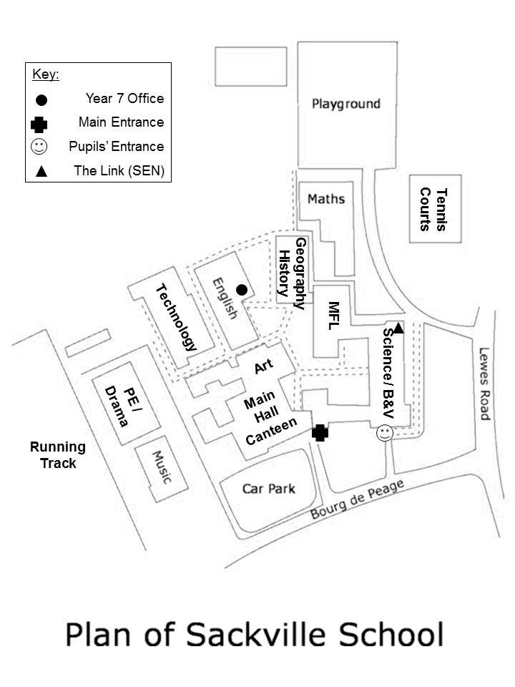
How Will I Know Where Everything Is?
Community offices
Here is the plan for Sackville School. We’ve not included all the rooms and different levels as it is quite complicated. Do not worry about it, once you’re here, you’ll quickly get to know where you are going.

Slide 13
School Buddies
At Sackville, we’re very proud of our Buddy System. We carefully select some of the finest Year 8 students to look after you.
They have to apply to be a ‘buddy’, to show good values and leadership. They have all had experience of what it’s like to be in where you are today.
You will meet them on the Induction Days in July and they will be with you in September too.

Slide 14
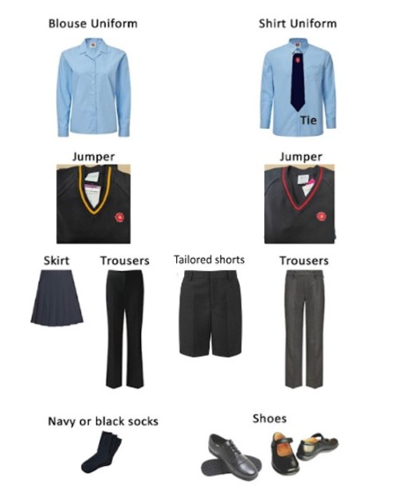
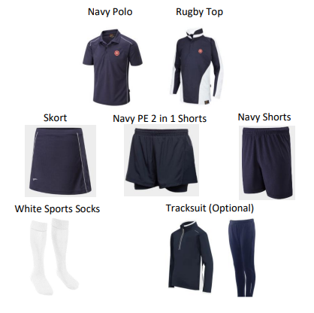
Uniform and PE kit

Slide 15
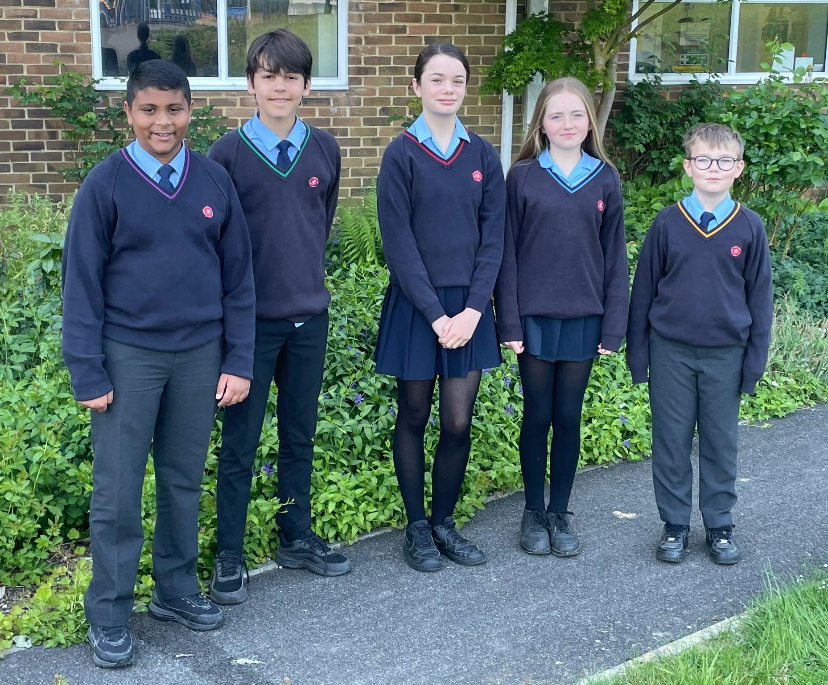
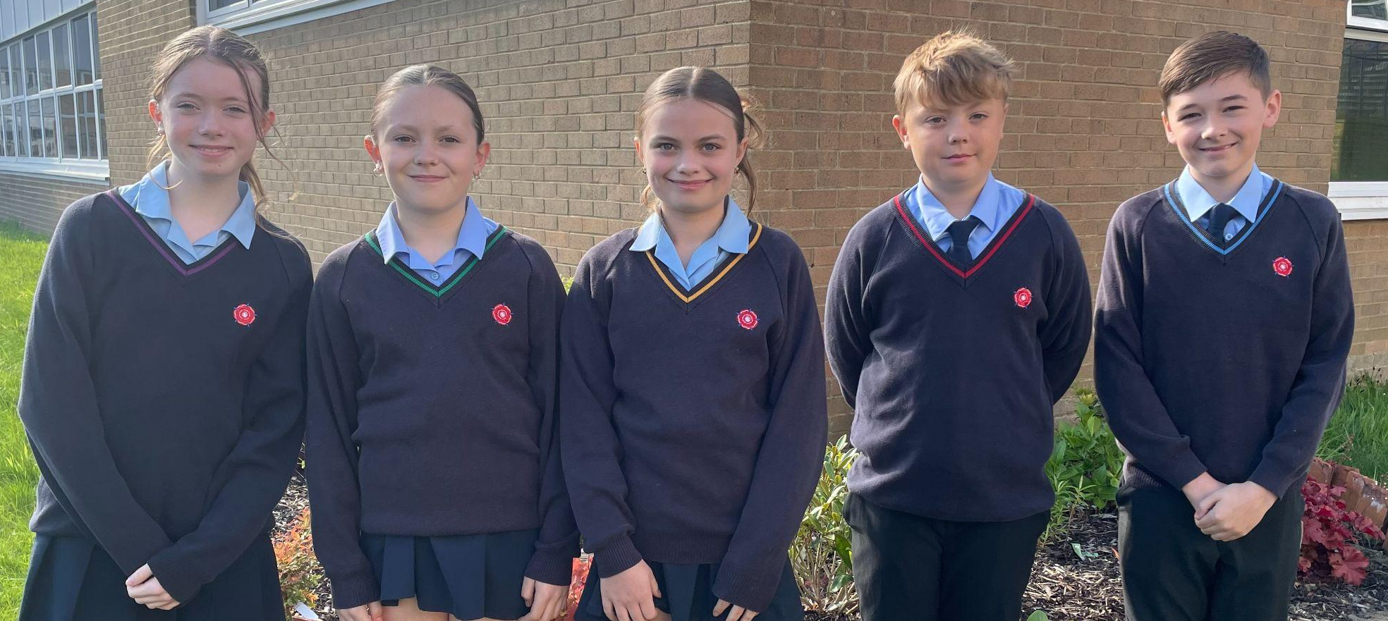
Our Year 7 students

Slide 16
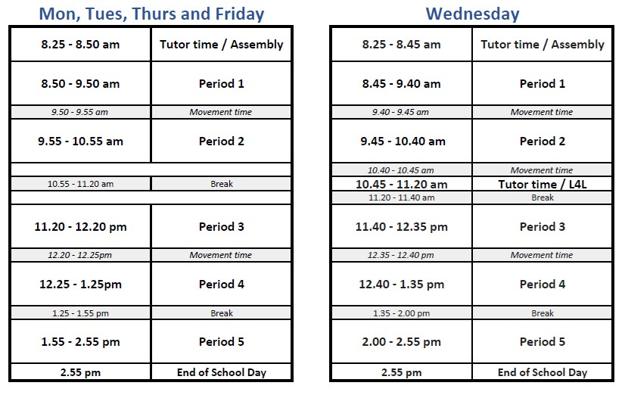
Sackville School Day

Slide 17
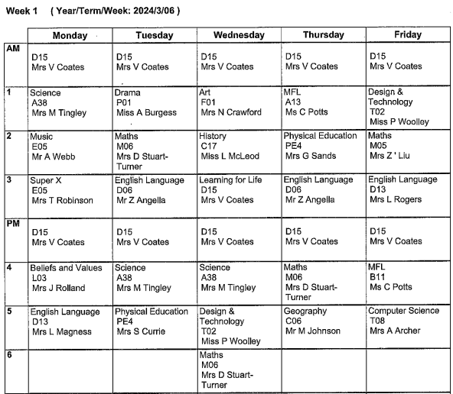
Example Timetable
Monday
Tuesday
Wednesday
Thursday
Regstration
MJN C05
MJN C05
MJN C05
MJN C05
Te
KTN T02
Fr
IGN B14
Pe
LRS Field 5
Bv
AMS A14
Pe
LRS Field 4
Ma
KHL M04
Sc
PWX A22
Mu
AWB E05
Sc
PWX A22
Dr
HWE P02
Fr
IGN B14
Ma
KHL M04
Ma
KHL M04
En
EGN D02
Hi
LMD C12
Gy
RHN C05
Ma
KHL M04
En
EGN D02
Sc
PWX A22

Slide 18
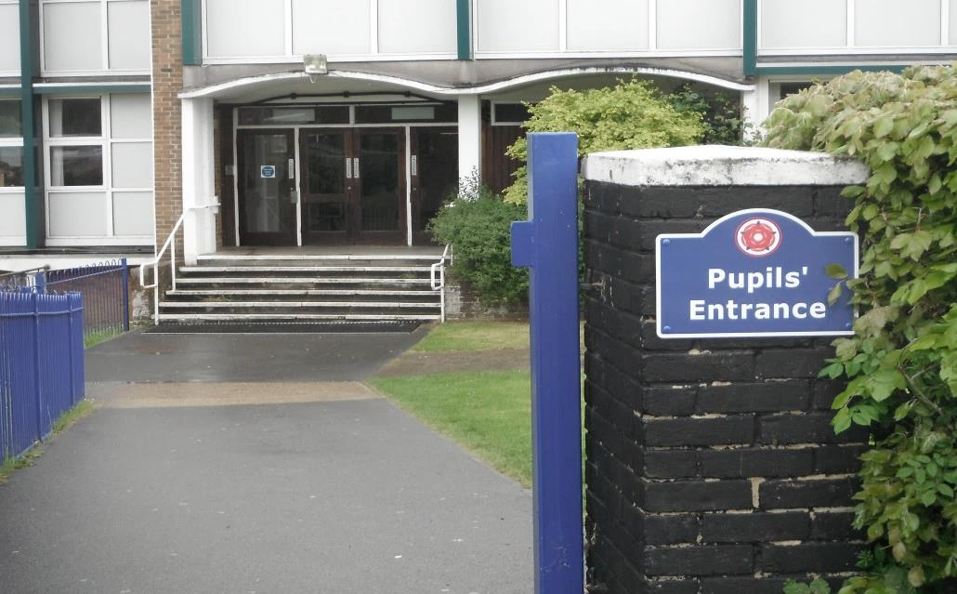
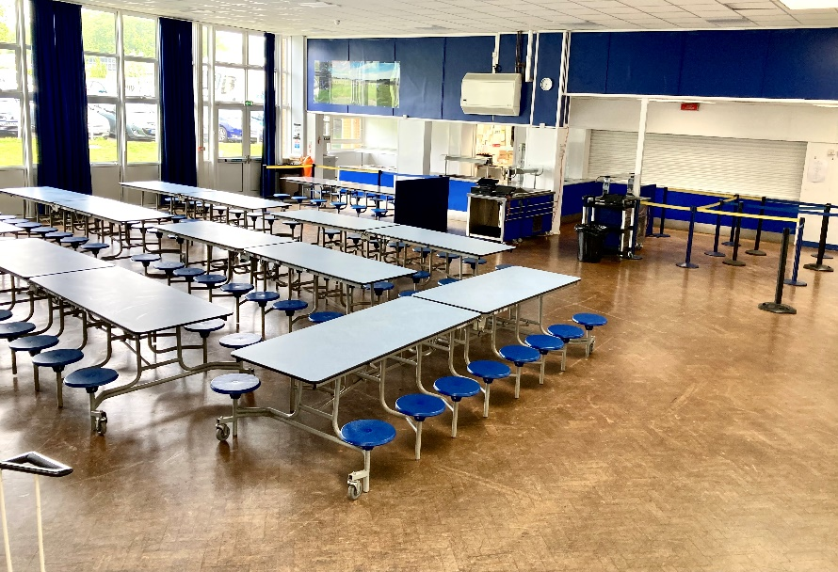
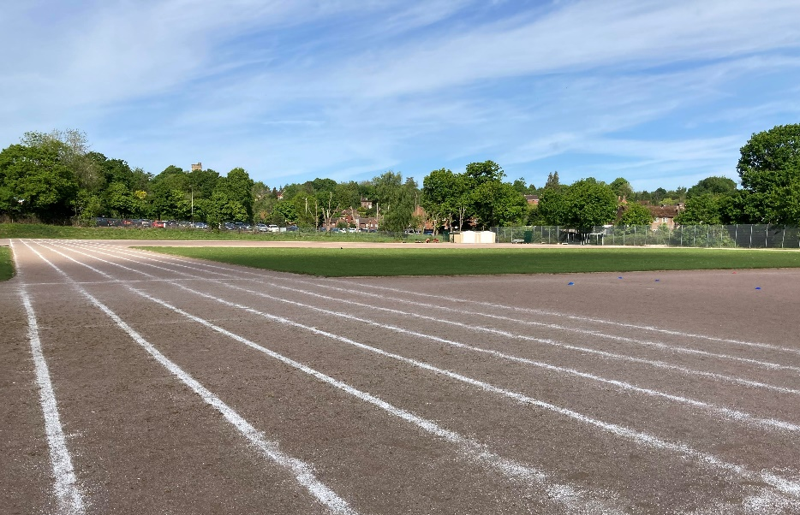
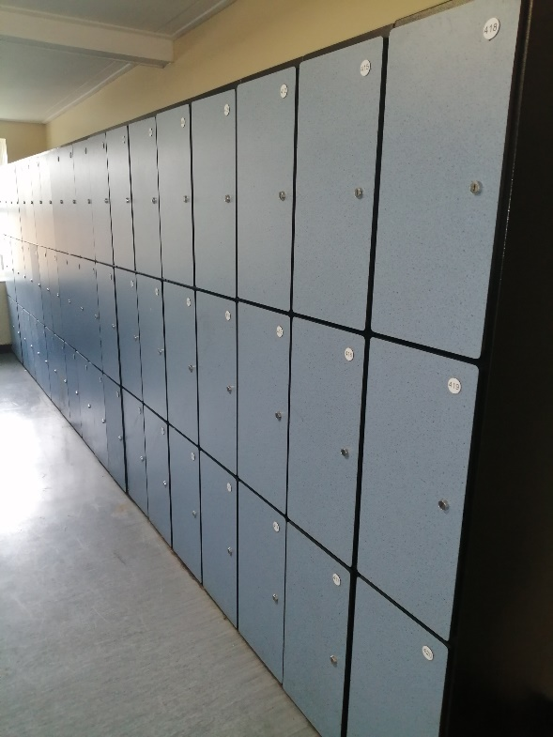
Can you guess where these
pictures are taken from?

Slide 19
Thank You.

