Slide 1
New Beginnings
2022

Slide 2
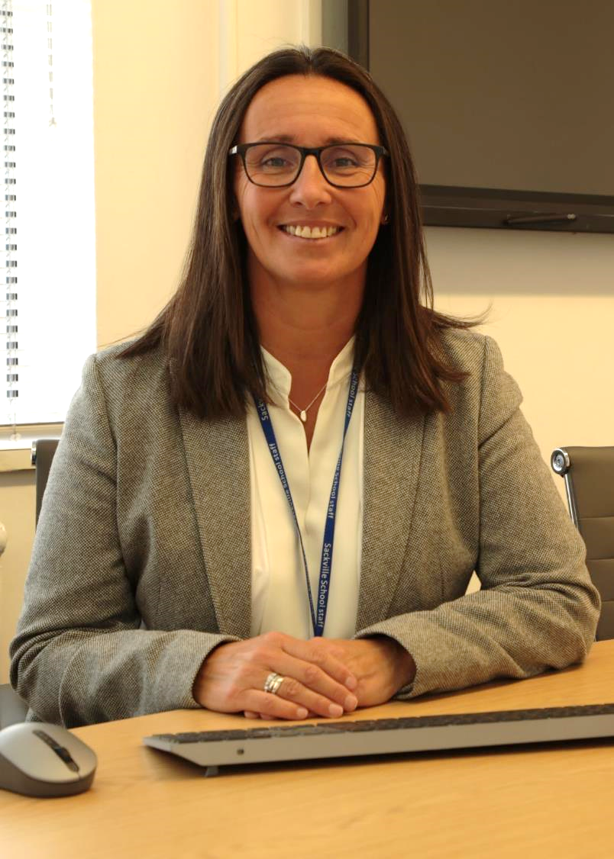
Welcome to The Team…
“As Headteacher, I’d like to welcome you to our wonderful community of learners at Sackville! You’ll find that the school very friendly and you will be strongly encouraged and supported to do your best every day that you’re here.
Sackville has many young people and staff who I’m responsible for looking after. I am lucky to be surrounded by so many great people who make sure that everything runs smoothly.
I’m based just opposite the reception area at the entrance of the school and I’m really looking forward to meeting you. Good luck!”
Ms Jo Meloni, Headteacher

Slide 3
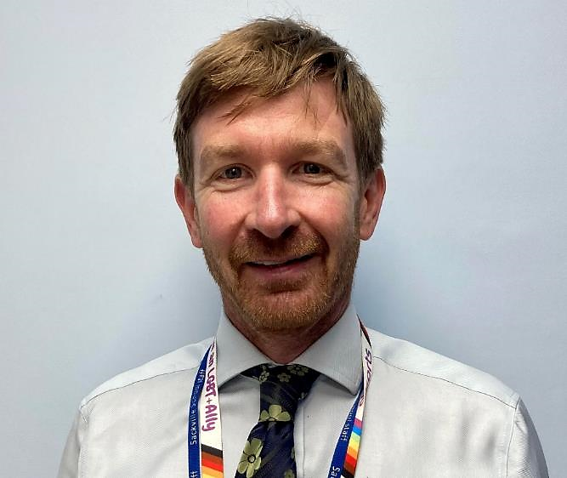
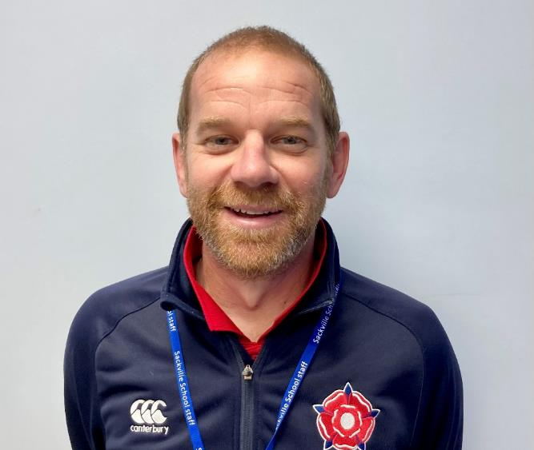
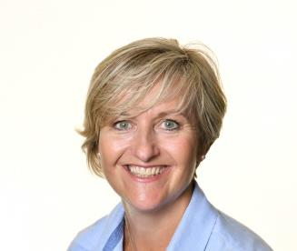
Mr Street,
Deputy Head
Mr Endersby,
Year 7 Leader
My name is Mrs Brown and my role is to manage your transition from your primary school to secondary school.
I am here to support you in any way I can to ensure your transition runs as smoothly as possible.
I have been talking to your teachers to find out more about you, so we can be ready for you to start great learning as you join Sackville in September.
We really look forward to getting to know each and every one of you. You will love Sackville, it is a wonderful school, full of amazing opportunities, which I urge you to take full advantage of. I am here to help you on this journey, and I cant wait to see you all in September.
Mrs. Brown
Mrs Brown, Transition Co-ordinator
“Welcome to Sackville.
My name is Mr Street and I am one of the Deputy Headteachers here at Sackville.
My responsibilities include the wellbeing of students. I’m keen that you start Sackville, feeling safe, confident and ready to learn.
I am really looking forward to meeting you on one of our transition days so I can tell you a little more about me but more importantly, find out a lot more about you. Take care and stay safe.”
Mr. Street
“Welcome to Sackville School. My name is Mr Endersby and I will be your Head of Year for your transition from primary to secondary school.
I’m looking forward to meeting you and getting to know you better as students but, more importantly, as members of the Sackville community.
At Sackville School we have many opportunities that I hope you will take full advantage of during your time here. I have no doubt that the more of yourself you put in, the more you will get out of your time here.
Good luck! We will be here to support you every step of the way.”
Mr. Endersby

Slide 4
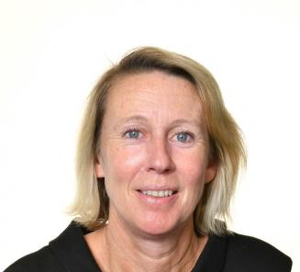
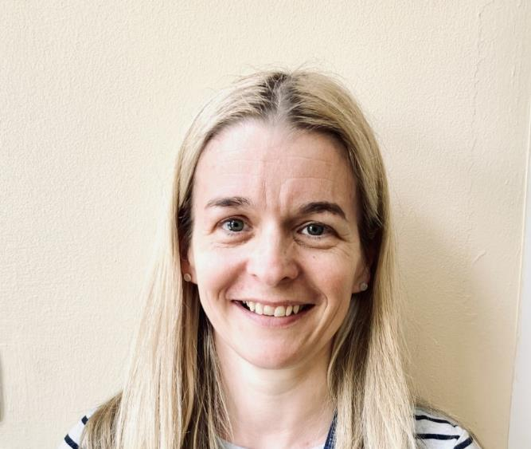
Mrs Tocher, Learning Mentor
“My name is Mrs Hunt and I work in the LINK.
I am the Special Needs Co-ordinator so I am someone who can help you or your parents if there is any extra help you need with your learning.”
Mrs Hunt
Mrs Hunt, Special Needs Co-ordinator
“Hello, my name is Mrs Tocher. I am the Learning Mentor at Sackville.
I work closely with the year team to help support your emotional and pastoral needs. I also run The BASE which is a welcoming place to be at break and lunch times if you are unsure of where to go.
I look forward to meeting you soon.”
Mrs Tocher

Slide 5
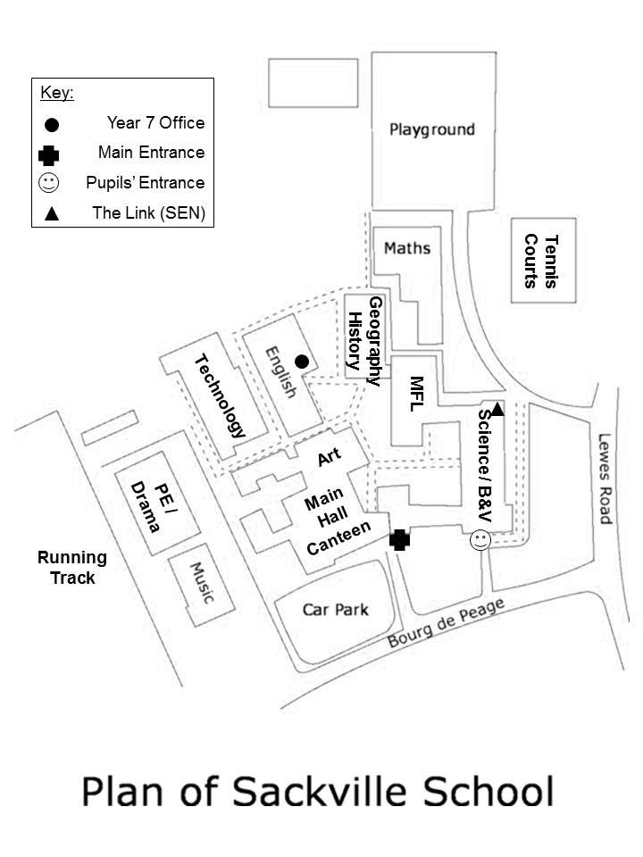
How Will I Know Where Everything Is?
Here is the plan for Sackville School. We’ve not included all the rooms and different levels as it is quite complicated. Do not worry about it; once you’re here, you’ll quickly get to know where you are going. It’s easy really – if you have English, go to the English block, and if you have Maths, go to the Maths block.

Slide 6
Sackville School Day
Tutor Time
Period 1
Period 2
Break
Period 3
Period 4
Lunch
Period 5
End of Day

Slide 7
Example Timetable
Monday
Tuesday
Wednesday
Thursday
Friday
Registration
EWE B05
EWE B05
EWE B05
EWE B05
EWE B05
Lesson 1
Te
HDN T02
Fr
IGN B14
Pe
LRS Field 5
BV
AMS A14
Fr
IGN B14
Lesson 2
Pe
LRS Field 4
Gy
MJN C04
Sc
PXW A22
Mu
THY E05
Hi
HGN C12
SC
PWX A22
Dr
ABY P02
Fr
IGN B14
Ma
JSI B02
En
JCK D01
Lesson 3
Lesson 4
Ma
JSI B02
En
ADT D02
Hi
HGN C12
Te
HDN T01
It
JLA C15
Lesson 5
Gy
MJN C04
Ma
JSI B02
En
ADT D02
SC
PWX A22
Ar
PAS F04

Slide 8
School Buddies
At Sackville, we’re very proud of our Buddy System.
We’ve carefully selected some of the finest Year 8 students.
They’ve all applied to be a ‘buddy’, have had training, and have the experience of what it’s like to be in the shoes of a new pupil.
You’ll meet them on the Induction Days in July and they’ll be with you in September too.

Slide 9
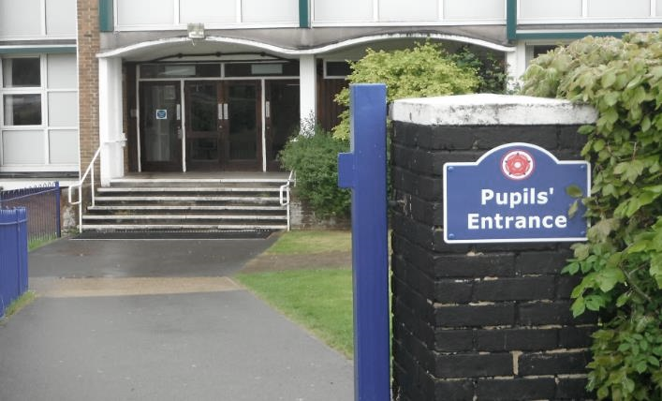
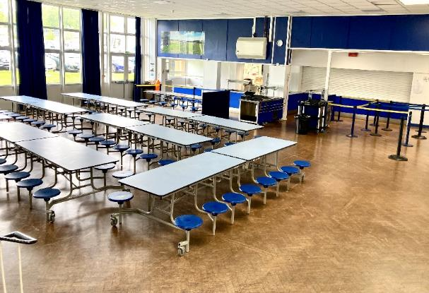
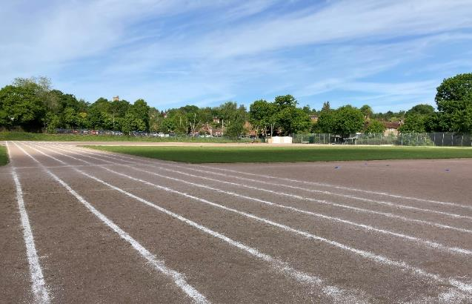
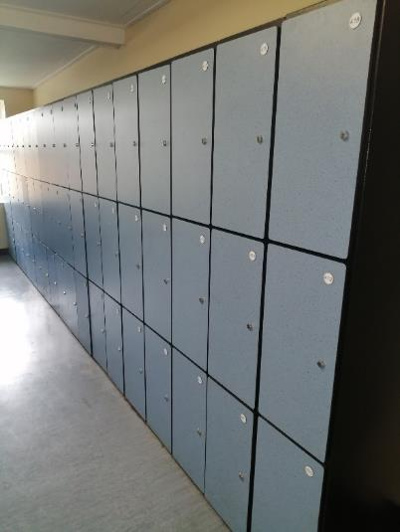
Can you guess where these
pictures are taken from?

Slide 10
Thank You.

