Slide 1
Session 1 Being awesome

Slide 2
Have you ever thought about the fact that we get to choose our attitude?
TASK: C hat with your partner about your attitude towards your favourite subject, your favourite hobby or your favourite sport?

Slide 3
Sometimes we have attitudes about ourselves we didn’t even know we had.
TASK: Chat with your partner about what your dream job would be?

Slide 4
Have you been 'kid average’ or ‘kid awesome’ at primary school?
TASK: Discuss with your partner what you think are differences between average and awesome?

Slide 5
Kid average is someone who:
• doesn’t try hard enough
• thinks everyone else is talented
• is lazy
• is scared of taking risks
• is worried about looking foolish
• doesn’t put their hand up in class
• thinks they will be okay, until it is too late.

Slide 6
Kid awesome is someone who:
• tries hard
• puts time into learning things
• is dedicated to what they want to achieve
• is focused
• doesn’t give up easily
• stays positive during hard times
• asks for help
• overcomes fears
• tries new things.

Slide 7
Are you:
Kid Average
or
Kid Awesome?
REMEMBER – You choose whether you like a subject or hobby or sport?

Slide 8
You can choose whether you are going to be average or
AWESOME!

Slide 9
Sometimes we are worried about failing or messing it up. That is what stops us being ‘kid awesome’. Being awesome takes perseverance.

Slide 10
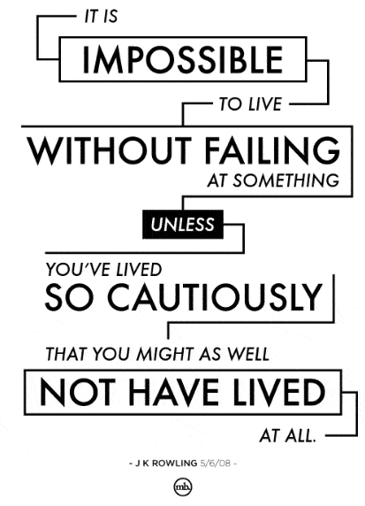
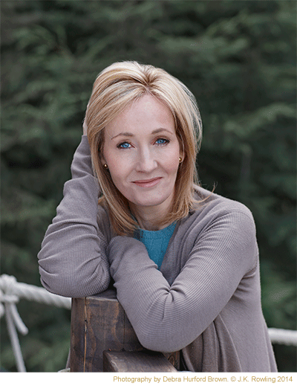

Slide 11
TASK: Discuss with your partner if there is anything holding you back?
Worried you can’t do things
Scared of hard work
Feeling stressed or anxious
Find it hard to focus
Scared of taking risks
Feeling embarrassed

Slide 12
PERSEVERANCE
What is the secret of success?
Trying your hardest
Doing something even though it is difficult
Not being afraid of making mistakes
Embrace challenges
Telling yourself that you CAN do it

